Slide 1




Software Tool Time

Slide 2


Slide 3
WebGL 2
biztripcru@gmail.com
© 2025, biztripcru@gmail.com, All rights are reserved.

Slide 4
WebGL 2 Tutorial (Part 3) – FBO, RBI
강사
경북대학교 백낙훈 교수
목표
WebGL 2 FBO, RBO에 대해 학습
Code
https://github.com/hwan-ajou/webgl-1.0.git

Slide 5
Contents ^{내용}
Graphics Pipeline Upgrade
Framebuffer Object
Renderbuffer Object
Render to RBO 프로그램

Slide 6
Graphics Pipeline Upgrade

Slide 7


Rendering 결과를 Texture Image로 사용
목표 : 방금 그린 image 를 texture image 로 사용
¹ draw an image
² read the image
³ use the image as a texture
⁴ draw the final image
texture memory
texImage2D
CC0, 2022.02.04
https://freesvg.org/dog-with-blue-eyes
back buffer
main memory
RGBA data
CC0, 2024.04.14
https://www.rawpixel.com/image/7675822/psd-face-person-vintage
drawings
read pixels
back buffer / front buffer
texture
display screen
CC0, 2022.02.04
https://freesvg.org/dog-with-blue-eyes
drawings

Slide 8
Pipeline Architecture 의 수정
목표 : 방금 그린 image 를 texture image 로 사용
before : read pixels from physical framebuffers
memory 공간의 구별
(physical) framebuffer
main memory
texture memory
frame buffer
vertex
input
vertex
processing
primitive assembly
rasterization
fragment processing
blend
(physical) framebuffer
© Illustration by biztripcru@gmail.com
texture
read pixels
texture image
image in main memory
tex image 2D
texture memory
main memory

Slide 9
Pipeline Architecture 의 수정
목표 : 방금 그린 image 를 texture image 로 사용
after : introducing frame-buffer object (FBO)
FBO는 선택용 스위치 역할만 수행 ^{(memory 할당 없음)}
FBO 에 연결되는 memory
(physical) framebuffer
main memory → render buffer object
texture memory
frame buffer
(physical) framebuffer
main memory
vertex
input
vertex
processing
primitive assembly
rasterization
fragment processing
blend
FBO
RBO
© Illustration by biztripcru@gmail.com
draw
texture
texture
texture memory

Slide 10
기존의 framebuffer 사용
FBO 에서 framebuffer 를 rendering 대상으로 선택
OpenGL의 default 상태
frame buffer
(physical) framebuffer
draw
main memory
vertex
input
vertex
processing
primitive assembly
rasterization
fragment processing
blend
FBO
RBO
© Illustration by biztripcru@gmail.com
texture
memory buffer
read pixels
texture memory

Slide 11
Render to Texture
FBO 에서 texture 를 rendering 대상으로 선택
texture image 에 직접 rendering
frame buffer
framebuffer
main memory
vertex
input
vertex
processing
primitive assembly
rasterization
fragment processing
blend
FBO
RBO
© Illustration by biztripcru@gmail.com
draw
texture
texture
texture memory

Slide 12
Off-screen Rendering
FBO 에서 RBO 를 rendering 대상으로 선택
RBO = render-buffer object
= main memory 상의 2D array
그래픽 카드 메모리가 부족할 때, main memory를 사용
fragment shader 와 연결이 곤란하므로, write-only buffer
depth buffer, stencil buffer
frame buffer
framebuffer
draw
main memory
vertex
input
vertex
processing
primitive assembly
rasterization
fragment processing
blend
FBO
RBO
© Illustration by biztripcru@gmail.com
texture
texture memory

Slide 13
Framebuffer Object

Slide 14
여러 개의 Framebuffer Object 사용 가능
A framebuffer object is a switch box
it does NOT have the real memory
FBO 를 여러 개 두고, 선택 가능
FBO #0 = physical framebuffer
FBO #0
(physical)
framebuffer
FBO #1
texture
FBO #2
RBO
vertex
input
vertex
processing
primitive assembly
rasterization
fragment processing
blend
© Illustration by biztripcru@gmail.com
texture
FBO #3
RBO

Slide 15
FBO Attachment Points
physical framebuffer = color buffer + depth buffer + stencil buffer
FBO has attachment points
color framebuffer → multiple color attachment points
동시에 여러 버퍼에 draw 가능
COLOR_ATTACHMENT0, . . . , COLOR_ATTACHMENTi
depth buffer → 1 × DEPTH_ATTACHMENT
stencil buffer → 1 × STENCIL_ATTACHMENT
© Illustration by biztripcru@gmail.com
FBO #1
COLOR_ATTACHMENT0
COLOR_ATTACHMENT1
DEPTH_ATTACHMENT
STENCIL_ATTACHMENT

Slide 16
FBO Scenarios
© Illustration by biztripcru@gmail.com
FBO #0
fixed
FBO #0 = physical framebuffer
attachment 변경 불가능 (fixed)
FBO #i : 사용자가 create, 관리
COLOR_ATTACHMENT0
physical color buffer
COLOR_ATTACHMENT1
fixed
DEPTH_ATTACHMENT
physical depth buffer
fixed
STENCIL_ATTACHMENT
physical stencil buffer
© Illustration by biztripcru@gmail.com
gl.framebufferTexture2D( )
gl.bindFramebuffer( )
FBO #i
color texture 2D with mipmap
OpenGL rendering pipeline
COLOR_ATTACHMENT0
COLOR_ATTACHMENT1
depth texture 2D
DEPTH_ATTACHMENT
STENCIL_ATTACHMENT

Slide 17
WebGL functions
WebGLFramebuffer buffer = createFramebuffer( );
void deleteFramebuffer( buffer );
create / delete FBO
void bindFramebuffer( gl.FRAMEBUFFER, buffer );
if buffer == null, use the default (real) framebuffer.
사용할 framebuffer object 를 선택
© Illustration by biztripcru@gmail.com
FBO #0
(physical)
framebuffer
FBO #1
texture
FBO #2
RBO
blend
texture
FBO #3
RBO

Slide 18
Renderbuffer Object

Slide 19
RBO
renderbuffer object : destination for a single 2D image
similar to a texture image
but, on the main memory location
gl.createRenderbuffer()
gl.bindRenderbuffer()
gl.renderbufferStorage()
gl.framebufferRenderbuffer()
gl.bindFramebuffer()
© Illustration by biztripcru@gmail.com
FBO #i
RBO
color buffer
OpenGL rendering pipeline
COLOR_ATTACHMENT0
COLOR_ATTACHMENT1
DEPTH_ATTACHMENT
RBO
depth buffer
STENCIL_ATTACHMENT

Slide 20
WebGL functions
WebGLRenderbuffer buffer = createRenderbuffer();
void deleteRenderbuffer( buffer );
create/delete RBO
void bindRenderbuffer( gl.RENDERBUFFER, buffer );
if buffer == null, unbind the current RBO
render buffer object 중의 1개를 선택

Slide 21
WebGL functions
void renderbufferStorage( GLenum target, GLenum internal, GLsizei width, GLsizei height );
target : RENDERBUFFER
internal would be
color-renderable (RGB8, RGBA8, …), or
depth-renderable (DEPTH_COMPONENT24), or
stencil-renderable (STENCIL_INDEX8)
allocate memory for width × height pixels
RBO
RGBA, w × h

Slide 22
Attaching RBO to FBO
void framebufferRenderbuffer( GLenum target, GLenum attachment, GLenum rboTarget, GLuint rboid );
attach an RBO to the current FBO
target should be FRAMEBUFFER
attachment is COLOR_ATTACHMENT0, etc.
rboTarget should be RENDERBUFFER
if rboid == 0, the renderbuffer is detached
© Illustration by biztripcru@gmail.com
FBO #i
COLOR_ATTACHMENT0
COLOR_ATTACHMENT1
DEPTH_ATTACHMENT
STENCIL_ATTACHMENT
RBO
RGBA, w × h

Slide 23
Attaching RBO to FBO
gl.createRenderbuffer()
gl.bindRenderbuffer()
gl.renderbufferStorage()
¹ prepare an RBO
² prepare an FBO
³ attach the RBO to FBO
⁴ read pixels, if needed
RBO
RGBA, w × h
gl.framebufferRenderbuffer()
gl.readPixels()
gl.createFramebuffer()
gl.bindFramebuffer()
© Illustration by biztripcru@gmail.com
FBO (selected)
OpenGL rendering pipeline
COLOR_ATTACHMENT0
image in main memory
COLOR_ATTACHMENT1
DEPTH_ATTACHMENT
STENCIL_ATTACHMENT

Slide 24
Render to RBO 프로그램

Slide 25
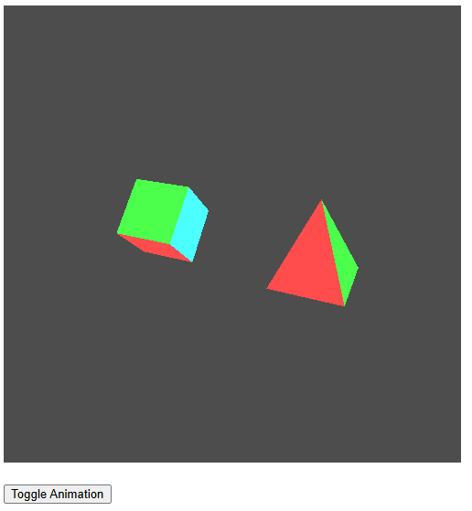
RBO로 전환할 프로그램 선택
rot-two-obj.js
rotating two objects
rtt-rot-two-obj.js
render-to-texture 예제에서는
2개의 drawing pipeline 필요
혼란을 방지하기 위해,
함수 이름에 "rtt_" prefix 적용

Slide 26
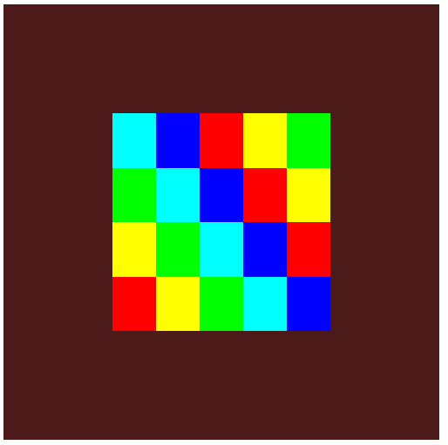

RBO를 화면에 보여줄 프로그램 선택
single-tex.js
texture image 1개를 rectangle로 출력

Slide 27
rbo-color.js
. . .
function initGL(canvas) {
try {
gl = canvas.getContext('webgl2', {
stencil: false, alpha: true, depth: true, antialias: false, preserveDrawingBuffer: true
});
var ext = gl.getExtension('WEBGL_depth_texture');
} catch (e) {
. . .
}
. . .
return true;
}

Slide 28
rbo-color.js
© Illustration by biztripcru@gmail.com
RBO
color buffer
FBO #i
var fbo;
var rbo_color;
var texObj_color;
var pixel_buf;
function initFBOandTex() {
. . .
// framebuffer
fbo = gl.createFramebuffer();
gl.bindFramebuffer(gl.FRAMEBUFFER, fbo);
// color renderbuffer
rbo_color = gl.createRenderbuffer();
gl.bindRenderbuffer(gl.RENDERBUFFER, rbo_color);
gl.renderbufferStorage(gl.RENDERBUFFER, gl.RGBA8, TEX_W, TEX_H);
gl.framebufferRenderbuffer(gl.FRAMEBUFFER, gl.COLOR_ATTACHMENT0, gl.RENDERBUFFER, rbo_color);
// done
gl.bindFramebuffer(gl.FRAMEBUFFER, null);
return testGLError("initFBOandTex");
}
COLOR_ATTACHMENT0
COLOR_ATTACHMENT1
DEPTH_ATTACHMENT
STENCIL_ATTACHMENT

Slide 29
rbo-color.js
function renderScene() {
. . .
// rtt part
gl.bindFramebuffer(gl.FRAMEBUFFER, fbo);
rtt_renderScene();
gl.readPixels(0, 0, TEX_W, TEX_H, gl.RGBA, gl.UNSIGNED_BYTE, pixel_buf);
gl.bindFramebuffer(gl.FRAMEBUFFER, null);
// my part
gl.useProgram(gl.progObj);
gl.bindBuffer(gl.ARRAY_BUFFER, gl.vertBuf);
gl.activeTexture(gl.TEXTURE0);
gl.bindTexture(gl.TEXTURE_2D, texObj_color);
gl.texSubImage2D(gl.TEXTURE_2D, 0, 0, 0, TEX_W, TEX_H, gl.RGBA, gl.UNSIGNED_BYTE, pixel_buf);
// draw func part
gl.clearColor(0.3, 0.1, 0.1, 1.0);
. . .

Slide 30
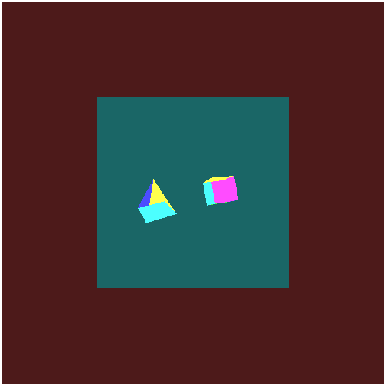
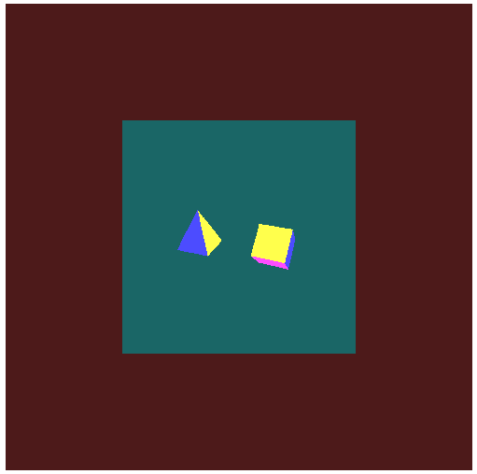
Your Challenge
rbo-color.js 의 미묘한 실패 !
depth 처리가 되지 않음
rbo-depth.js 로의 전환
check the details !
© Illustration by biztripcru@gmail.com
RBO
color buffer
FBO #i
COLOR_ATTACHMENT0
COLOR_ATTACHMENT1
DEPTH_ATTACHMENT
RBO
depth buffer
STENCIL_ATTACHMENT

Slide 31
Contents ^{내용}
Graphics Pipeline Upgrade
Framebuffer Object
Renderbuffer Object
Render to RBO 프로그램

Slide 32
Software Tool Time (소프트웨어 툴 타임)
(CC-BY-NC 4.0) KNU and Ajou Univ.
Visit “Software Tool Time” channel in YouTube : https://www.youtube.com/c/SoftwareToolTime
All product names, trademarks, and/or company names are used solely for identification and belong to their respective owners.
“Software Tool Time” video is licensed to the public under a Creative Commons Attribution 4.0 License (https://creativecommons.org/license/by/4.0/)
Twin Musicom’s African Drums (Sting) is licensed to the to the public under a Creative Commons Attribution 4.0 License (Artist: http://www.twinmusicom.org/)

Slide 34

본 영상은 2021,2022년도 과학기술정보통신부 및 정보통신기획평가원에서 지원하는 SW중심대학사업의 결과물 입니다.
본 영상의 내용을 전재할 수 없으며, 인용할 때에는 반드시 과학기술정보통신부와 정보통신기획평가원의 'SW중심대학사업'의 결과물이라는 출처를 밝혀야 합니다.

